Slide 1
Calibration of a Timing Skew between Gyroscope Measurements in a Strapdown INS
Alexander Kozlov¹, Fedor Kapralov¹, Alexander Fomichev²
¹ Navigation and control lab, Lomonosov Moscow State University, Russia
² Moscow Institute of Electromechanics and Automatics, Russia

Slide 2
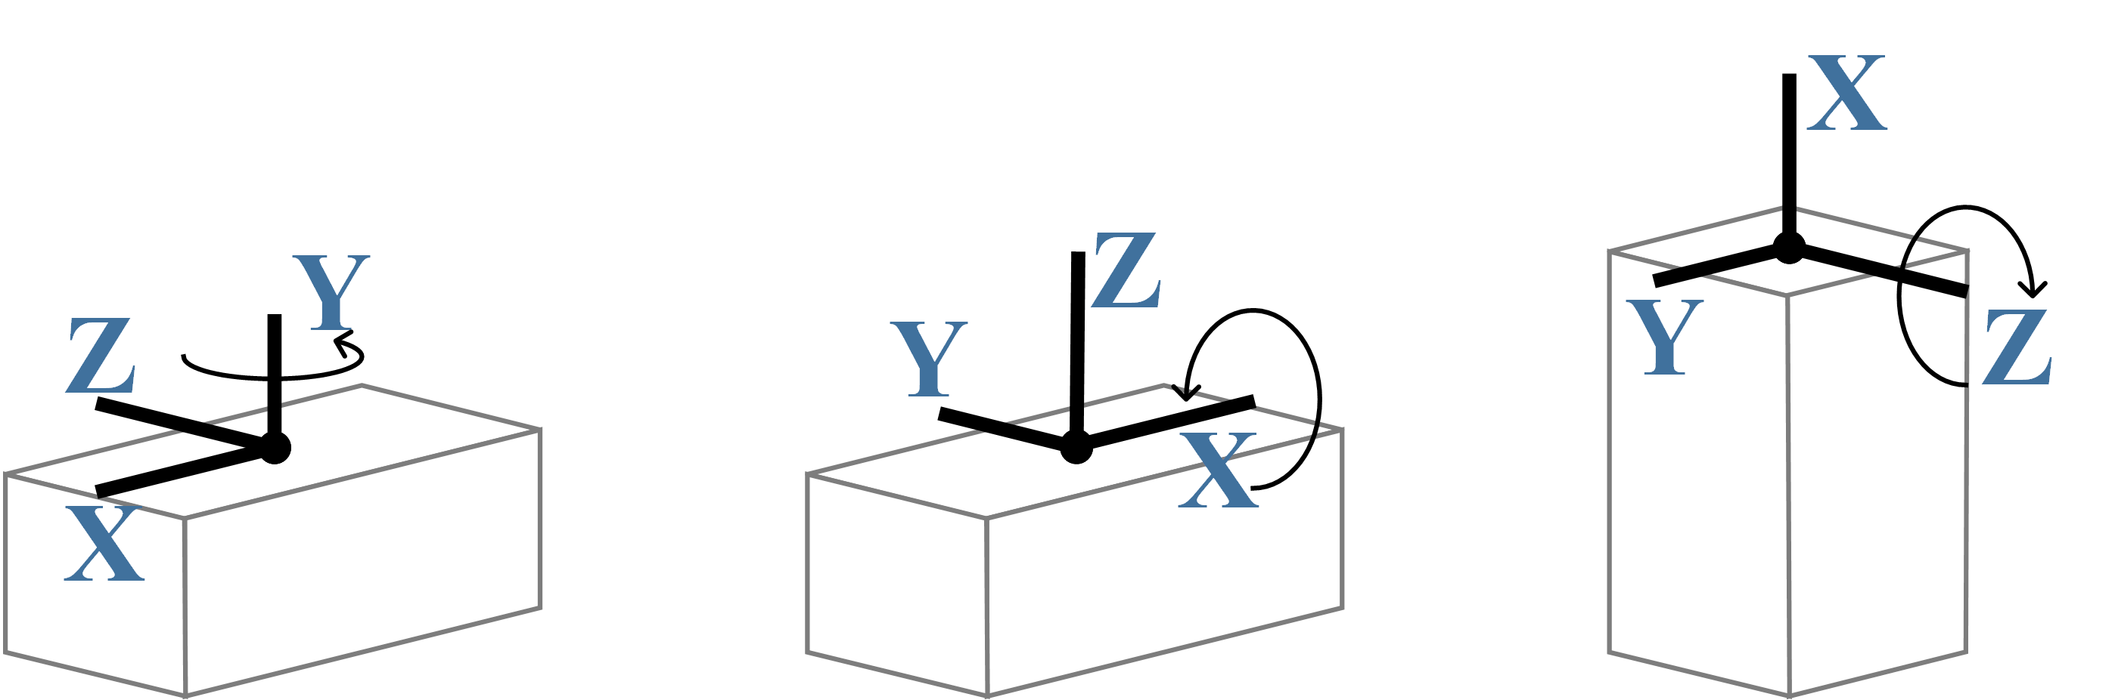
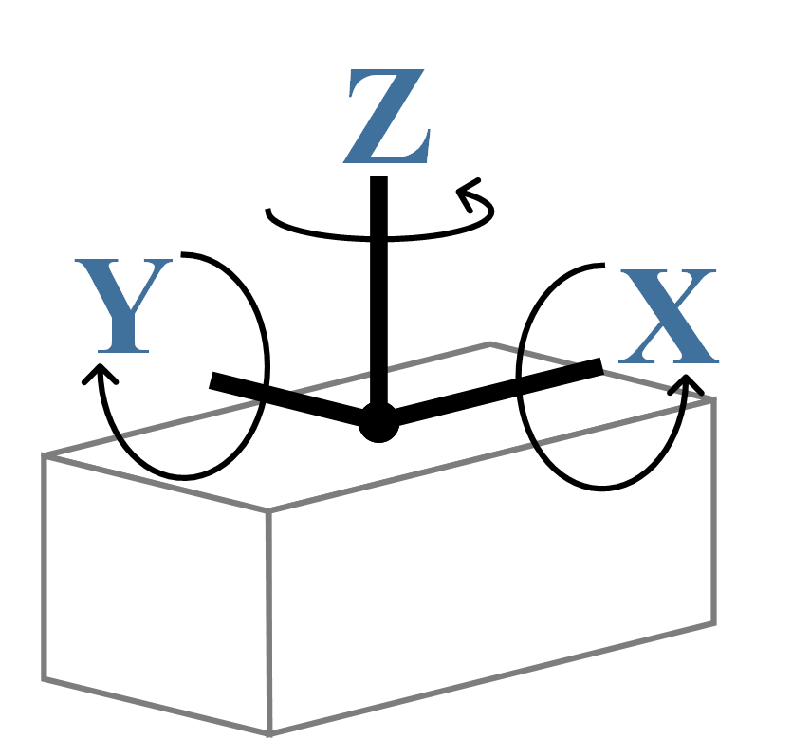
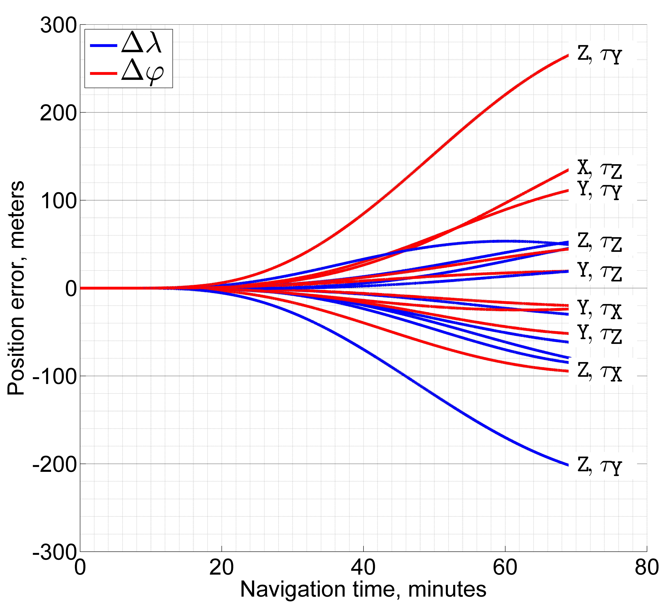
Calibration of a Timing Skew between Gyroscope Measurements in a Strapdown INS
Alexander Kozlov, Fedor Kapralov (MSU), Alexander Fomichev (MIEA)
Every good instrument is such as good…
…as its calibration is.
Unknown metrologist
parameter estimation accuracy
Parametric model
model completeness
Why timing skew
between gyroscope measurements?
Attitude is crucial
Timing skew can be overlooked in factory testing
(includes mostly single-axis rotations vs. in real world)
Generally underestimated in acceptable magnitude
(small fraction of an integration step seems to be ok)
May emerge from a variety of causes:
    sequential data polling,
    procedure scheduling,
    filtering (produces phase delays),
    preliminary calculations,
    errors in program code …
Impossible to measure directly
…
Effect of simulated
10 μsec timing skew
in actual vibrational testing, 0.2% of Δt @ 200 Hz (!)

Slide 3
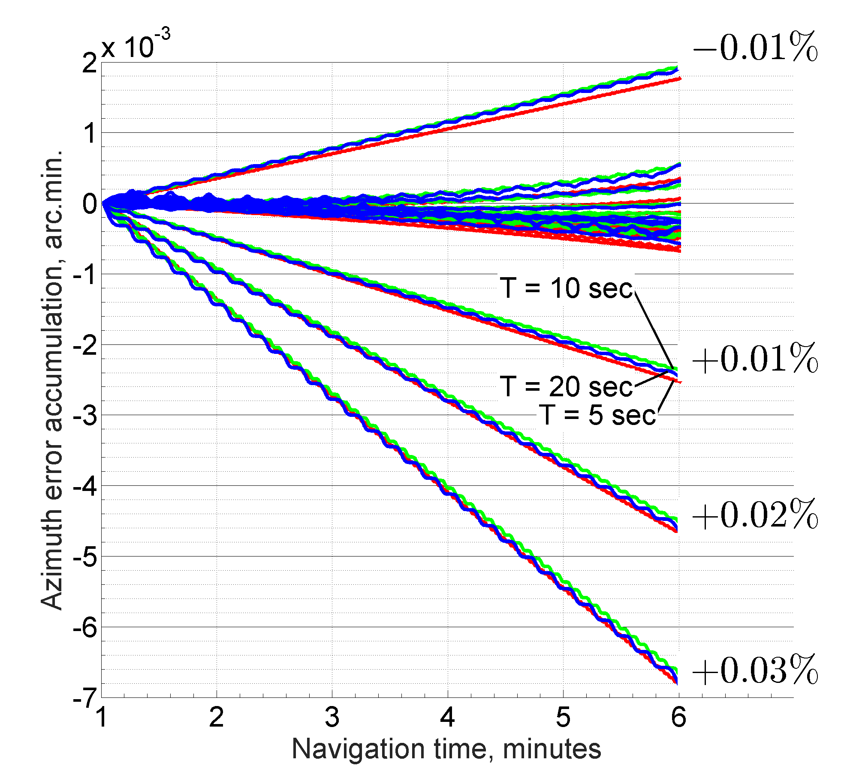
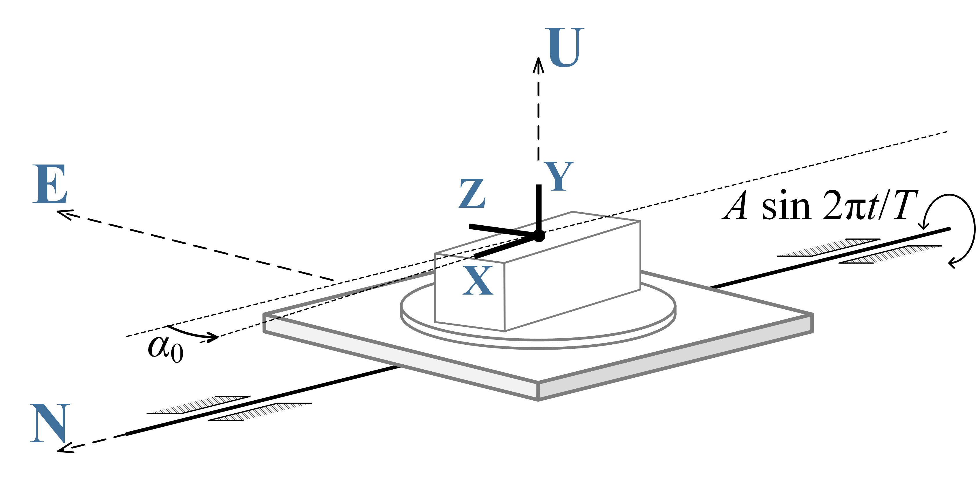
Calibration of a Timing Skew between Gyroscope Measurements in a Strapdown INS
Alexander Kozlov, Fedor Kapralov (MSU), Alexander Fomichev (MIEA)
Calibration experiment:
the timing skew should be
observable
(considerable effect on navigation)
predictable
(explicit relation to measurable quantities)
separable
(other factors should average or cancel out)
Mitigating the effect of instrumental errors
residual calibration errors of the INS
imperfect instrumentation of the experiment
Azimuth error drift average rate
due to instrumental errors either is negligible,
or does not depend on the period of oscillations
Thus, we should use differencing between two experiments with different periods of oscillations
The method has been tested
in three case studies so far
An example for
scaling factor error
in Y gyroscope signal
α₀ | A | T | τ_{XZ} | → | ⟨ν_{U}⟩
45° | 90° | 5 sec | 1 μsec (!) |  | 0.145°/hr (!)

